Slide 1
Mnaasged Child & Family Services

Slide 2
Mnaasged (Minaaseged)
“The Beautiful Rays of the Rising Sun, Shedding Light on the Future – Our Children”

Slide 3
Wind
First Nation
Clans
Elders
Grandmothers
Aunties
Mother
Earth
First Nation
Fire
Community
Elder s
Elders
Cousins
Community
First Nation
Extended Family
Child
Extended Family
Cousins
Sisters
Brothers
Father
Uncles
The Original
Circle of Care
Grandfathers
Elders
Our Service Model is centered on the Original Circle of Care and our goal is to restore that Original Circle of Care
Community
Traditional Ways of
Protecting Children
First Nation
Water
Notes:
5 MIN
It starts with the child in the centre
(Click) Around that child is the immediate family, including parents and siblings.
(Click). The immediate family does not stand alone. They are supported by Aunties and Uncles, Cousins,
(Click) And many more extended family. You will see here we have another circle that includes Grandmothers and Grandfathers and there might be many others who are considered part of this group.
(Click) We then add the Elder’s which play a very important role in supporting all of these persons and relationships.
(Click). The broader community has a role to play as well. This might include a teacher or a neighbor or friend or just someone from the community. And the clan that can also be a huge support to the family.
(Click)And finally we have the first nation who can play a very important role in helping to ensure that children remain within this Original Circle of Care.

Slide 4
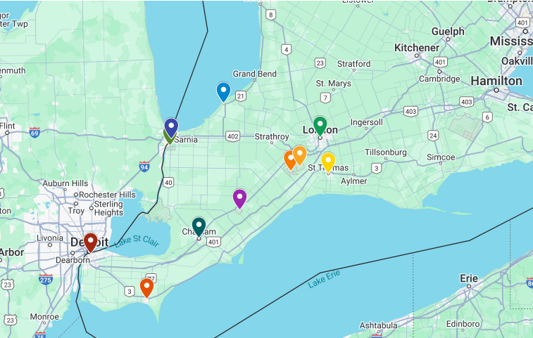
Service Area
Aamjiwnaang First Nation
Caldwell First Nation
Eelunaapeewi Lahkeewiit - Delaware Nation
Kettle & Stony Point First Nation
Munsee Delaware Nation
Oneida Nation of the Thames
Chatham
London
Sarnia
St. Thomas
Windsor

Slide 5
Stage E
Ongoing Development and Sustainability
The Steps Toward
Achieving Designation
Stage D
Designation as a Provincial Child and Family Services Agency
Alternative Care License
Interim Provision of Care for our children under OPR License
Stage C
Transition Process: Take on CAS Service Responsibilities with CAS Mentorship
Stage B
Capacity Development:
Refine Policies and Develop Programs
2024
Stage A
Readiness:
Reaffirm Community and First Nation Support
2021
2020
Notes:
5 MINS
Describe the OPR Licensing process; and the fee-for-service contracts with CASs to provide First Nation care for children in the care of the CASs. This service will include culturally based programs for children and youth in care and their families, including culturally based access/ visiting programs

Slide 6
Indigenous knowledge
Language Journey Project to develop video resources of the language journey of each community serviced through MCFS
Language Coalition Committee including all 6 communities for the language revitalization efforts of MCFS for children/youth/families we service
Rites of Passage Program being developed for each of our communities
Traditional resources and information being customized for Indigenous Authorized Worker training in collaboration with ANCFSAO
Indigenous Knowledge will be a whole system of support from the children and families we service to the staff team receiving mentoring and traditional learning opportunities

Slide 7
Alternative Care
Family-based out of home care for children/youth in need of protection, when necessary. Reunification as an essential part of their care and our first goal. Our services are rooted in our indigenous values and cultural practices – this ensures that the children and the Alternative Care families receive the appropriate supports during this time.
The seven Grandfather Teachings are used to guide all of us in our professional lives. MCFS carry these values throughout our programs, our activities, our support, and our guidance. On July 15, 2020, the Ministry officially recognized HEART and SPIRIT as an alternative to the Ministry standard SAFE and PRIDE.

Slide 8
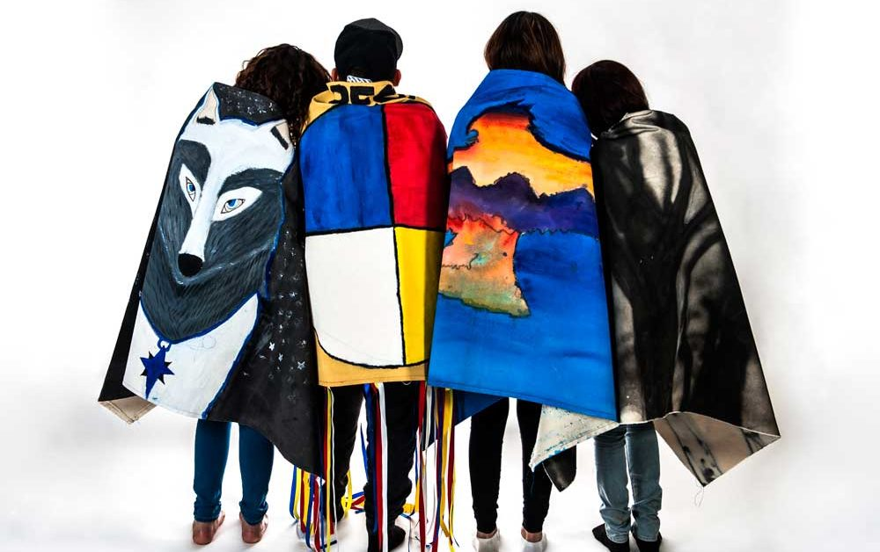
Youth services
Youth in Transition provides support for youth ages 14-25 who are in the process of transitioning out of the care of CAS
This program helps youth obtain skills to support them in their journey into the adult stages of life
Examples: youth/Elder connection, housing supports, Indigenous culture/spirituality, employment resources, health/mental health referrals and resources, developing strategies/tools for success, interpersonal relationships, etc.
Post Majority Care is essential to the commitment to the well-being of Indigenous young adults who have reached the age of majority and are aging out of care or who have previously been in care, between the ages of 18-25 – offering continued support and guidance as youth navigate the complexities of independent living
Upholds the 8 pillars to adulthood: financial, educational/professional development, housing, relationships, culture/spirituality, health/wellbeing, advocacy and rights, emerging adulthood development

Slide 9
Educational video series on Indigenous Teen Wellness
Topics and Key Focuses
Stress and the Brain
Depression and Anxiety
Interview on Identify
Interview on Self-Care
Inequities
Employment & Training
Staff will also receive a segment on the importance of self-awareness, including its definition, relevance, and methods to foster self-care to prevent burnout; discussions on belief in oneself and in the potential of the youth they support
This initiative, in collaboration with Jennifer Slay, is designed to empower Indigenous teens in care and the dedicated staff at Mnaasged
The goal is to provide essential insights into mental health, identity, and self-care, equipping them with the knowledge and tools necessary to overcome challenges and thrive

Slide 10
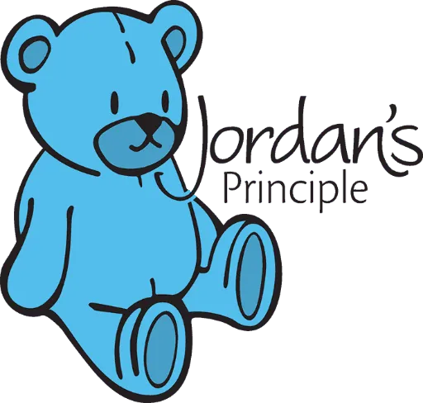
Our Jordan’s Principle Unit has been operating since October 2019 and the team includes a Supervisor, two Navigators, Data Management Worker, and a Finance Clerk
We service and advocate for our registered First Nation children within our catchment area residing in Windsor, Sarnia and Woodstock

Slide 11
We are growing
We are building capacity to strengthen our circle of support to meet the needs of the children, youth, and families within our communities and beyond

