Slide 1

Full Designation Target: June 21, 2025
ISC CAPITAL WORKSHOP PRESENTATION
January 10, 2024

Slide 2
Introduction
Mnaasged (Minaaseged) means,
"The Beautiful Rays of the Rising Sun, Shedding Light
On the Future - Our Children"
​
The Name Mnaasged Was Given To Us By Elder Mary Sturgeon,
Chippewa of the Thames First Nation

Slide 3
Introduction – Child and Family Services
Mnaasged Provides Various Child Welfare Programs and Services to Indigenous Families and Children using Holistic Indigenous Cultural Beliefs and Values of It’s Six First Nation Members.
Mnaasged was Licenced (June 21, 2021) to Deliver Alternative Care (Foster) Services in Southwestern Ontario using the Family “Heart and Spirit Program”.
Mnaasged is on Schedule to have Full Childrens Aid Society Designation by June 21, 2025.

Slide 4
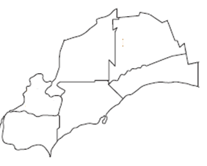
Five Children Aid Societies (CAS) in Southwestern Ontario
Population
CAS Territories Determined by County - Major Cities in Each County
Middlesex
London
Sarnia
Lambton
Elgin
St Thomas
Lake
St. Clair
Kent
Windsor
Essex
Chatham
Data Source: Each CAS

Slide 5
Five Children Aid Societies (CAS) in Southwestern Ontario
Population
County – (CAS) Population Territories Determined by County
Lambton (SLCAS)
Population (Growth 1.2%) | 128,154
Indigenous ID | 6,030
Status Individuals | 3,715
First Nations in County | 5,336
Middlesex LMCAS)
Population (Growth 9.9%) | 500,563
Indigenous ID | 12,725
Status Individuals | 5,690
First Nations in County * | 7,184
Middlesex
Lambton
Elgin
Lake
St. Clair
Elgin (STECAS)\
Population (Growth 6.5%) | 94,752
Indigenous ID | 2,045
Status Individuals | 770
No First Nation in County | -
Kent
Essex (WECAS)
Population (Growth 6%) | 422,860
Indigenous ID | 12,055
Status Individuals | 2,855
First Nation in County | 506
Essex
Kent (LINCK)
Population (Growth 3.7%) | 113,6543
Indigenous ID | 3,760
Status Individuals | 1,200
First Nation in County | 1,361
Data Source: Statistics Canada - Census 2021
* First Nation ISC Oct 2023

Slide 6
Five Children Aid Societies (CAS) in Southwestern Ontario
Indigenous Children & Families in Need By County.
Calculations… Two Data Intakes
March 30, June 30, 2023… One to
Come December 30, 2023
CAS | Cases
SLCAS | 201
LMCAS | 413
STECAS | 58
LINCK | 98
WECAS | 234
Total | 1,004
Note*
Middlesex
413
Lambton
201
COTT
Walpole Island
Elgin 58
Lake
St. Clair
Kent
98
Essex
234
Data Source: CAS
* Numbers of Indigenous Children do NOT include Walpole Island First Nation (Bkejwanong) and Chippewas of the Thames First Nation.

Slide 7
Mnaasged First Nation Membership (6)
Indigenous Children & Families in Need,
Local First Nations in Perfect Position
Middlesex
413
Munsee Delaware
Kettle Stony Point
Lambton
201
Oneida First Nation
Aamjiwnaang
Elgin 58
Lake
St. Clair
Kent
98
Essex
234
Delaware First Nation
Caldwell

Slide 8
Mnaasged First Nation Membership Population On & Off Nation
First Nations | Total Population | On Nation | Off Nation
Kettle & Stony Point | 2,647 | 1,397 | 1,250
Aamjiwnaang | 2,589 | 1,004 | 1,585
Caldwell | 506 | 2 | 504
Delaware Nation | 1,361 | 600 | 761
Munsee Delaware | 714 | 177 | 537
Oneida | 6,470 | 1,945 | 4,525
Total | 14,287 | 5,125 | 9,162

Slide 9
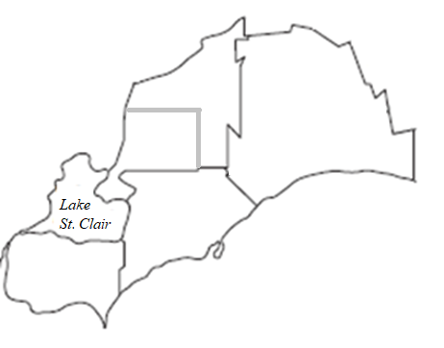
Seven Service Zones
Merge Middlesex and Elgin County
Divide Lambton into Two Zones
Zone Three London
Zone One
Zone
Two
Zone Four
Aamjiwnaang
Zone Seven Windsor
Zone Five
City – Zone
Zone Six

Slide 10
New Zones (Seven Plus Munsee Delaware Nation)
# | New Service Zones | # Cases
1 | Kettle & Stony Point | 67
2 | Aamjiwnaang | 134
3 | London | 207
4 | CMO | 264
5 | Delaware Nation | 98
6 | Leamington (Western Hub) | 162
7 | Windsor | 72
 | Total (As of This Date) | 1,004
 | Note* Caldwell ATR
Middlesex
413
London
Kettle Stony Point
Munsee
Delaware
Lambton
201
Aamjiwnaang
Elgin 58
Kent
98
Oneida First Nation
Windsor
Delaware First Nation
Essex
234
Caldwell
Legend
First Nations
Merge Middlesex and Elgin County
Divide Lambton into Two Zones
Cities
New Zone Facility

Slide 11
Drive Time in Minutes From Select Zone Facility Locations
\\\\\\\\\\\\\\\\\\\\Kettle Point
(Rule is 60 + Minutes to Client from Faculty)
London
Munsee
Oneida
Delaware Nation
Leamington
Windsor
Aamjiwnaang
Kettle Point
Service Location |  | Time Minutes | Time Minutes | Time Minutes | Time Minutes | Time Minutes | Time Minutes | Time Minutes
London | - | 38 | 34 | 62 | 115 | 128 | 77 | 67
Munsee CMO | 38 | - | 11 | 37 | 88 | 98 | 64 | 58
Oneida CMO | 34 | 11 | - | 43 | 89 | 99 | 64 | 58
Delaware | 62 | 36 | 41 | - | 64 | 73 | 58 | 60
Leamington | 115 | 90 | 90 | 64 | - | 43 | 95 | 121
Windsor | 128 | 102 | 102 | 74 | 43 | - | 109 | 134
Aamjiwnaang | 77 | 63 | 63 | 58 | 95 | 107 | - | 44
Kettle Point | 67 | 57 | 57 | 59 | 120 | 130 | 44 | -
(Google Maps with Speed Limits)

Slide 12
Zones – Clusters (5)
.
Interchangeable Staff between Zones (60 Minutes Drive if Required)
Zone 3 - London
Zone 1 - Kettle Stony Point
Zone 2 -Aamjiwnaang
Zone 4 - CMO
Clusters
Zone 7 - Windsor
Cluster One - Windsor, Leamington
Cluster Two - Leamington, Delaware
Zone 6 - Leamington
Cluster Three - Delaware, Aamjiwnaang, Kettle Point
Cluster Four - Delaware, CMO, London
Zone 5 - Delaware
Cluster Five - CMO, London, Aamjiwnaang, Kettle Point

Slide 13
Staff Determination
Number of Indigenous Cases
Determines Staff Requirements
Determines
Facility Requirements

Slide 14


Key Staff Ratios Based on Case Workload
One “Children Circle of Care Helper” (CCCH) Handles 12 Cases
Lambton
Elgin
Kent
Essex

Slide 15
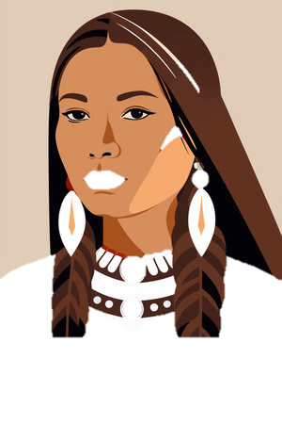
Key Staff Ratios Based on Case Workload
Six “Children Circle of Care Helpers” (CCCH) Requires One Supervisor
Elgin
Essex
Kent
Lambton
Lambton
Lambton
Lambton
Lambton
Lambton
Elgin
Elgin
Elgin
Elgin
Elgin
Elgin
Essex
Kent
Essex
Kent
Essex
Kent
Essex
Kent
Essex
Kent
Essex
Kent

Slide 16
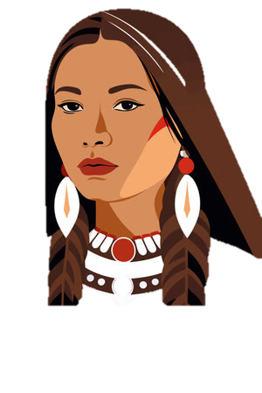
Key Staff Ratios Based on Case Workload
Support
Staff
Supervisor (1)
Support
Staff
Indigenous
Knowledge Keeper (IK)
Lambton
Administration Support
Six Children Circle of Care Helpers
Elgin
Kent
Essex
72 Child Care Cases
Family Circle of Care Worker
Visitor Work Station

Slide 17
Example - Kettle & Stony Point First Nation - Zone One 67 Cases
Reports to West Hub IK Supervisor
11 Staff
Supervisor (1)
Indigenous
Knowledge Keeper
Lambton
Elgin
Six Children Circle of Care Helpers
Administration Support
Kent
Essex
Reports to West Hub FCCW Supervisor
67 Child Care Cases
Visitor Work
Station
Family Circle of Care Worker

Slide 18
Facility Determination
Number of Indigenous Cases
Determines Staff Requirements
Determines
Facility Requirements

Slide 19
Facility Determination
Office Square Footage
The below numbers should give you an idea of the typical sizes for different types of work areas within the office space:
Large Private or Shared Office: 200 to 400 square feet
WECAS Leamington Office average 434 Square feet per employee
Medium Private or Shared Office: 150 to 250 square feet
Small Private Office: 90 to 150 square feet
Open Space Workstations: 60 to 110 square feet per employee
Work Group Areas: 80 to 100 square feet per employe

Slide 20
Our Ideal Facility Determination
Square Footage Mnaasged Facilities
Calculations include Hallways, Bathrooms, Board Rooms, Interview Rooms, Furnace & Electrical Rooms, Storage Rooms, Lunch Room, Kitchen, Janitorial Room, Reception, Future Space Requirements, Covid 19 Protocol Entrance Space and Actual Office Space…
500 Square Feet per Employee
(Subject to Architecture Analysis and Actual Space Available on First Nations (Very Limited Space Available On First Nations)

Slide 21
Facility Requirements Overview
# | New Zones | # Cases | Staff | Ideal Facility Sq. Feet | Existing Space | Prospect Today Sq. Feet | Tenure
1 | Kettle & Stony Point | 67 | 11 | 5,500 | Yes | 2,300 | Lease 5 Year
2 | Aamjiwnaang FN | 134 | 22 | 11,000 | Yes | 2,300 + | Lease 5 Year
3 | London | 207 | 36 | 18,000 | No | - | Buy or Lease
4 | CMO - Head Office FN | 264 | 71 | 35,500 | No | - | Build Then Lease
5 | Delaware Nation FN | 98 | 11 | 5,500 | Yes | 4,006 | Lease
6 | Leamington (Western Hub) | 162 | 40 | 20,000 | Yes | 12,000 | Lease From CFN
7 | Windsor | 72 | 11 | 5,500 | No | - | Buy/Lease
 | Total | 1,004 | 202 | 101,000 | - | - | -

Slide 22
Facility Requirements Overview
# | New Service Zones | # Cases | Full Services Staff | Local CAS | Teams First Wave | Start Date First Wave | Start Date Second Wave
1 | Kettle & Stony Point FN | 67 | 11 | SLCAS | 1 | Jan/2024 | Complete
2 | Aamjiwnaang FN | 134 | 22 | SLCAS | 1 | Jan/2024 | -
3 | London (City) | 207 | 36 | LMCAS | 3 | - | -
4 | CMO - Head Office FN | 264 | 71 | LMCAS STECAS | 4 | - | -
5 | Delaware Nation FN | 98 | 11 | LINCK | 1 | Feb/2024 | Complete
6 | Leamington (Western Hub) | 162 | 40 | WECAS | 3 | 12,000 | -
7 | Windsor (City) | 72 | 11 | WECAS | 1 | - | Complete
 | Total |  | 202 |  | 14 | - | -

Slide 23
Lambton
Elgin
Kent
Essex

Slide 24
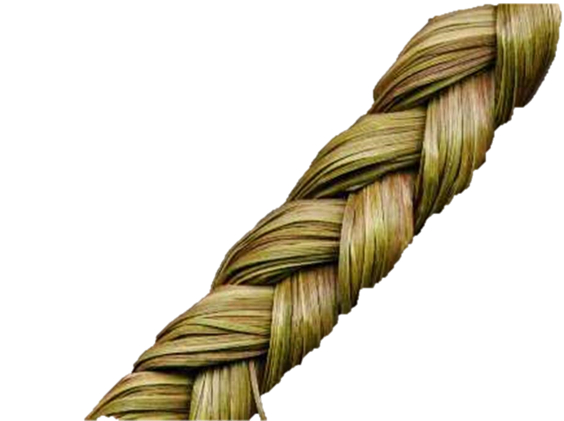

Miigwech
Anushiik
Lambton
Yaw^ko
Elgin
Kent
Essex
Thank you
24

